Slide 1
Welcome to High School
Class of 2026

Slide 2
Meeting Topics
Registration and Scheduling
Graduation Requirements/Graduation Plans
Core Class Requirements
Endorsement Pathways/CTE/Electives
High School Transcripts/Earning Credits/Grade Point Averages (GPA)
B.E.S.T.
Attendance
Types of testing and test purpose
Scholarships and Resumes
High School Staff to Know

Slide 3
Registration and Scheduling
Registration
Online through parent portal ☺ ☺ ☺ ☺ ☺
If you do not have an account you need to create at https://portal.ascender.esc15.net/ParentPortal/login?distid=207901
You will need your student’s parent portal ID to link your student to your account. You can request from campus secretary.
Registration for the 2022-2023 school year is open.
Make sure to fill our ALL FORMS and check phone numbers.
High School Scheduling
In Person – 1st Week of August, watch for detailed schedule
A parent or guardian needs to attend with 9th grade students
Students will review and finalize schedule
Students and parents will Verify and sign Graduation Plan

Slide 4
Graduation Requirements/ Plans
Foundation High School with Endorsement -26 Credits:
4 English
4 Math
4 Science
3 Social Studies
1 Fine Art
1 PE or PE Equivalent
2 Languages other than English (LOTE)
7 Electives (4 need to go together)
Other Requirements:
5 End of Course (EOC) Tests: English I, English II, Algebra, Biology, US History
CPR Training
Speech Proficiency
Interaction with a Police Officer Training

Slide 5
Endorsements
Students are required to pick an endorsement when entering 9th Grade. A student not wanting to participate in FHS with Endorsement program may opt out after successfully completing sophomore year. Until that time, all students will plan as though they will earn an endorsement.
*FHS with Endorsement is required to enter 4 year college/university straight out of high school.
*Without an endorsement, students will need to earn an associates degree and transfer to a 4 year college/university.

Slide 6
Endorsements
Endorsement Options at EHS:
Science, Technology, Engineering, and Mathematics (STEM)
Business and Industry
Agriculture, Food and Natural Resources
Business Management
Finance
Hospitality and Tourism
Public Service
Law, Public Safety, Corrections and Security
Health Science
Arts and Humanities
Languages: 2 years of 2 languages, or 4 years of 1 language
Social Studies
Fine Arts
Multi-Disciplinary
***Please see the TEA Graduation Toolkit for more information.

Slide 7
Freshmen Courses
World History
English I or English I Honors (Weighted 5 Points)
Biology or Biology Honors (Weighted 5 Points)
Algebra, Geometry, or Geometry Honors (Weighted 5 Points)
Spanish I ****Credit by Exam Opportunity
Art I or Band (Unless student was in band in 8th Grade)
Athletics or PE (Only if not in a TEAM Sport)
Elective Options (1-2) Depending on courses:
* Principles of Hospitality *Principles of Law *Principles of Agriculture *BIM I
*Audio/Video Technology *Accounting I *BIM II *Introduction to Welding
***End of Course Preparation – Students that do not pass the 8th Grade Reading or Math STAAR are required to complete an EOC preparation class until they pass the related EOC.

Slide 8
Transcripts
Transcripts are official documents that document student achievements during high school. This is the document that colleges receive from the school. This document includes:
Semester and Final Grades
Credits Earned
Cumulative GPA on 100 Scale
Cumulative GPA on 4 point scale
Class Rank
Test Scores – STAAR EOC, ACT, SAT, TSIA 2, AP Exams
Other Requirements: Speech Proficiency, CPR, Interaction with a peace officer training
Performance Acknowledgements such as Dual Credit Completion, Bi-literacy, High Performance on College Entrance Exams and AP Testing

Slide 9
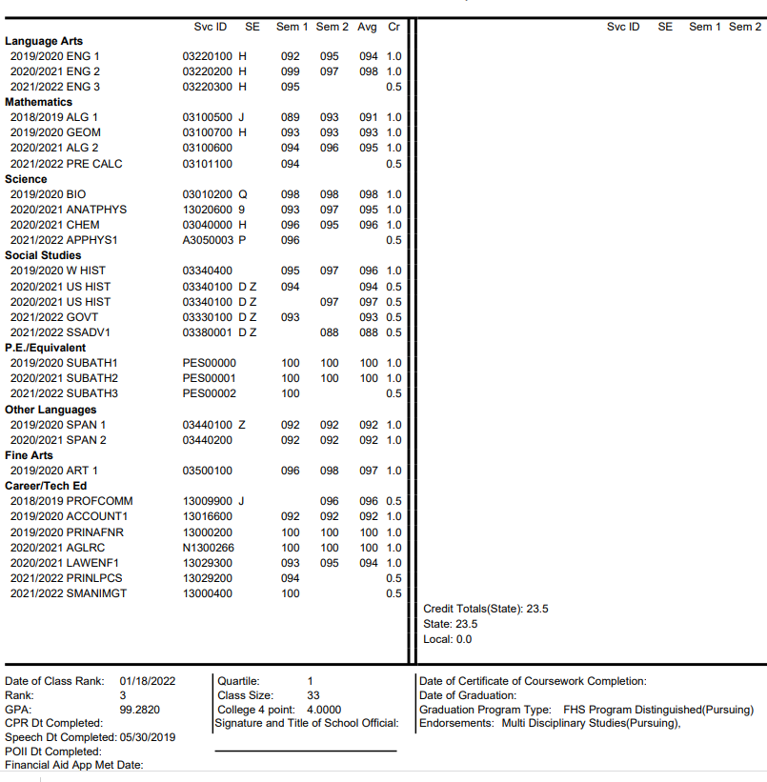
Transcript Examples

Slide 10
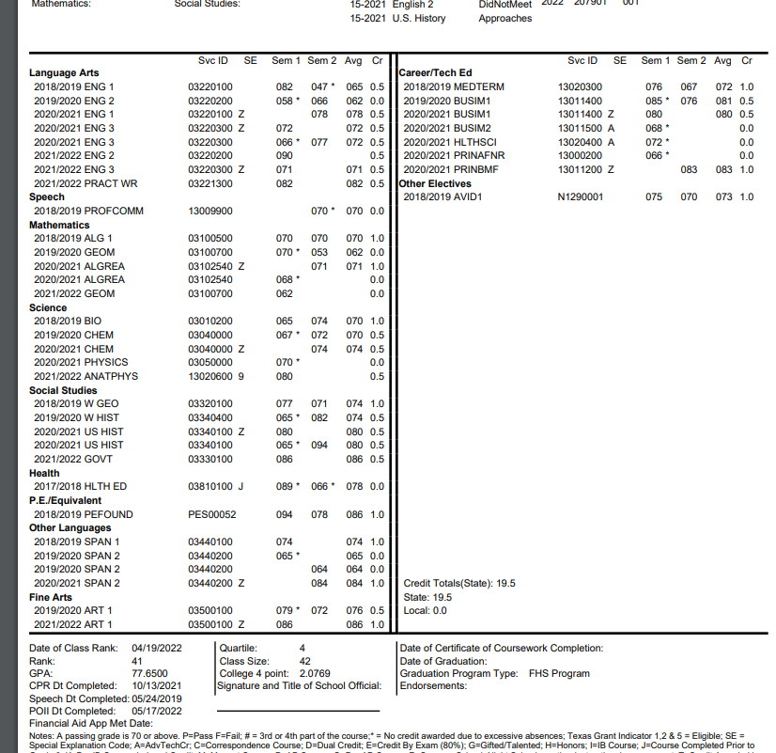
Transcript Examples

Slide 11
B.E.S.T.
B.E.S.T. is mandatory tutoring that is assigned by the High School principal every three week grade reporting period. The intent of B.E.S.T. is to help student pass and gain credit.
Students are responsible to check the B.E.S.T. schedule if they fail a class.
B.E.S.T. takes place M-TH from 7:40 a.m. until 7:55 a.m.
Failure to attend may result in lunch detention, after school detention, or ISS.

Slide 12
Attendance
Attendance is important for student success.
If your student must be absent:
Parent or Guardian –
*Call the office and inform of student absence
*Send a note back to school with your student when they return
Student –
*Turn note into the office and get a Blue Slip
*Have each teacher sign the Blue Slip and return it to the office
*Check with teacher about make-up work.
Students must be in attendance 90% of the offered class period to get credit for that class.
Attendance is an exemption criteria for semester and final exams. Even if it is excused.

Slide 13
Review Student Course Requests

Slide 14
Testing At EHS
STAAR EOC’s: State Assessments mandated by TEA
*English I, English II, Algebra, Biology, and US History
*Students cannot opt out. Not testing = did not meet passing score.
*Individual Graduation Committees end with the class of 2023. IGC’s allow students that have passed 3 of 5 EOC’s to graduate.
TSIA2: College Readiness Tests that show students are able to work at the college level. Can take locally for $4/section, at Howard College for $15/section, or at Angelo State University for $30/section.
Advance Placement (AP) Tests: Are given to any student that completes an AP course. Scoring a 3 or higher, depending on college attending, will count as college credit in that subject area.

Slide 15
Testing At EHS
College Entrance Exams: Used as part of admission and scholarship application process.
*ACT is offered to 10th -12th grade students during each semester.
*SAT is offered to 12th grade students in the Fall and 11th-12th in the Spring.
*These are the ACT and SAT School Day program rules – not mine or the schools.
*Students can register online to take a Saturday Administration of either of these tests. I can help them with this by request.
Test Preparation: UIL/Advisory Period is a time students use to get prepared for College Readiness Tests and Entrance Exams.
TSIA2: accuplacer.org (free account), SureScore (provided by EHS through grant)
ACT: onlineprep.act.org (paid account – school will provide to every students that is a 10th grade student or that already meets TSIA 2 benchmark
SAT: khanacademy.org (free account)

Slide 16
Scholarships
Students need to start applying for scholarships ASAP! Do not wait until senior year!
Use my webpage as a guide: https://www.scisd.net/Page/1732
Raise Me: Micro - scholarship System https://www.raise.me/
If you are not going to use RaiseMe, Keep some form of running record that includes:
Extracurricular Activities
Volunteer Experience
Awards & Honors
Work Experience
Example: UIL Social Studies, August 21-April 22, 3 hours per week

Slide 17
High School Staff to Know
Perry Graves, Principal: perry.graves@scisd.net
Lyndi O’Neil, Counselor: lyndi.oneil@scisd.net
Homeless/Foster Care Liaison, Testing Coordinator, Dual Credit Coordinator, and RTI Coordinator
Debbie Ballew, Secretary: Debbie.ballew@scisd.net
Martha Medrano, Attendance Clerk: Martha.Medrano@scisd.net
Ram Moreno, Athletic Director: ram.Moreno@scisd.net
Chris Castleman, Special Education and Section 504: christopher.castleman@scisd.net
Bridget Chancellor, LPAC/ESL and Dyslexia: bridget.chancellor@scisd.net
Sharon Spinks, Migrant Coordinator and GT Coordinator: Sharon.spinks@scisd.net
All faculty can be found at: https://www.scisd.net/site/Default.aspx?PageID=103

Slide 18
Questions?

